Slide 1
HCC Survival Prediction
Machine Learning Project
- Vijay Mukkala

Slide 2

Problem Statement
To classify the patient with the given
diagnosis into Survival(0) or not(1)
Which model fits better provided given the data

Slide 3
Dataset
The dataset comprises of 165 observations of 50 feature columns.
Dataset consists of:
Categorical variables
Discrete Variables
Continuous Variables
Prediction : Class – Nominal variable (Survived(0) , died(1))
This dataset has missing values of 10.22% of the whole dataset and also is a case of imbalanced dataset.

Slide 4
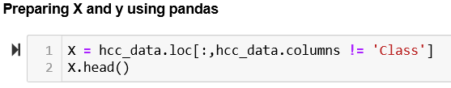

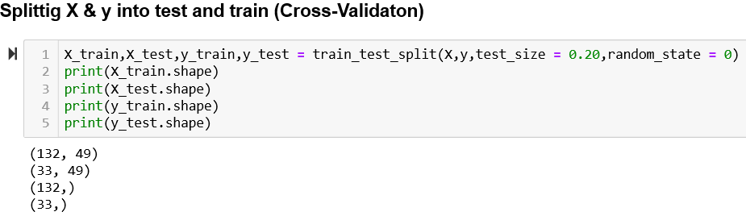
Cross validation
Splitting the data into train and test for X(Explanatory variables) & y(Target variables).
Cross validating the data at the start will make the test data foreign to the model and hence avoiding the overfit.

Slide 5
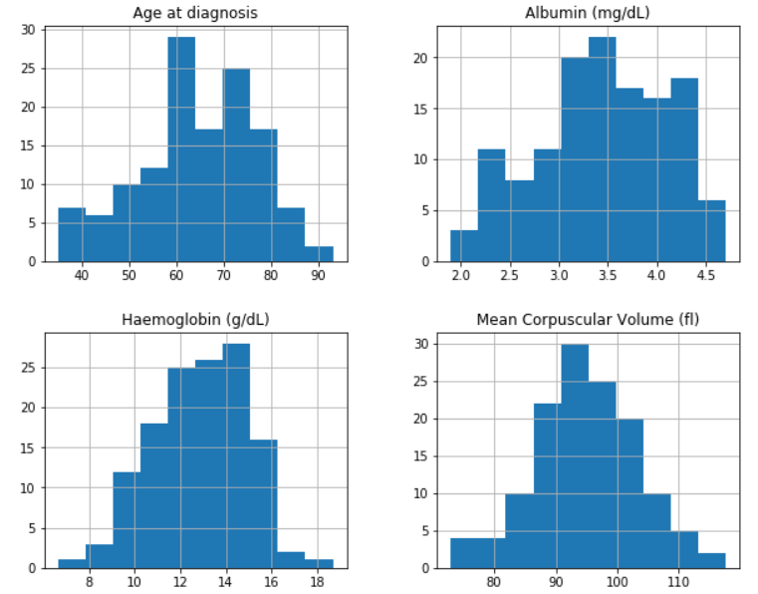
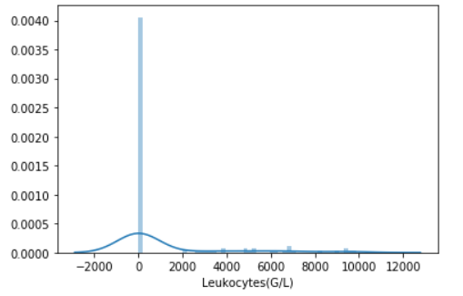
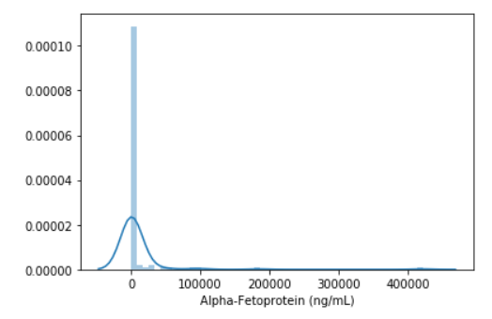
Exploratory Data Analysis
Imputing Missing values :
- For columns having Gaussian distribution(as shown in the picture)
the missing values are replaced by Mean.
- For columns having Skewed distribution the missing values are replaced
by Median.
- For Categorical values , the missing values are replaced by frequent values(Mode)
Dropping the columns having more zero values as these will not help for further analysis [ Fig. below]

Slide 6
Exploratory Data Analysis
Outlier treatment :
- Capping or Censoring technique : capping the maximum and /or minimum of a distribution at an arbitrary value
- The numbers at which to cap the distribution can be determined using the inter-quantal range proximity rule
One hot encoding on Categorical variables

Slide 7
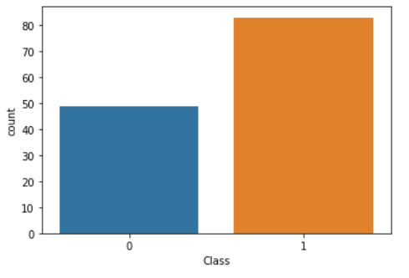
Exploratory Data Analysis
Distribution of target variable :
From the above figure we see that the distribution of target variable is imbalance so we can implement sampling techniques.

Slide 8
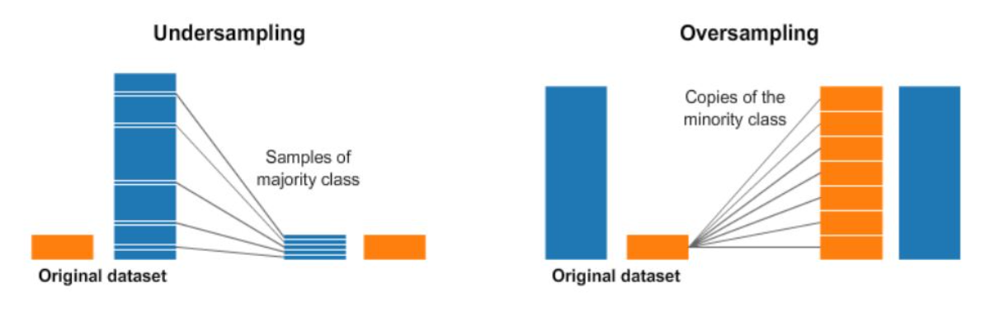
Random Under sampling & Oversampling
Under sampling : Under-sampling balances the dataset by reducing the size of the abundant class. This method is used when quantity of data is sufficient.
Over sampling : oversampling is used when the quantity of data is insufficient. It tries to balance dataset by increasing the size of rare samples.
We are going to use Oversampling for our dataset as the quantity of data is less

Slide 9
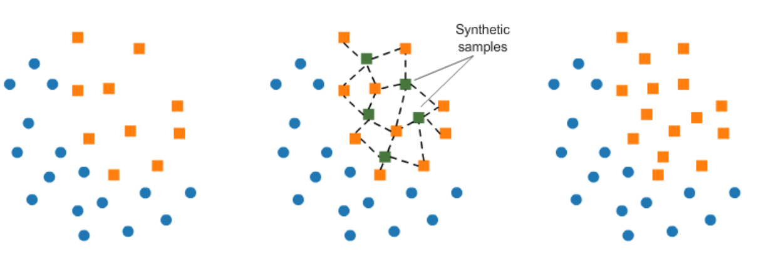
Oversampling using SMOTE
SMOTE – Synthetic Minority Oversampling Technique : It works randomly picking a point from the minority class and computing the k-nearest neighbors for this point. The synthetic points are added between the chosen point and its neighbors.

Slide 10
Machine Learning Models Used
1.) Logistic Regression
2.) Naïve Bayes
3.) Random Forest
4.) Support Vector Classifier
5.) PCA

Slide 11
F1 Score
ALGORITHM | F1 Score
Logistic Regression | 0.82
Naïve Bayes | 0.70
Random Forest | 0.67
Support Vector Classifier | 0.76
PCA + Logistic Regression | 0.74
PCA + Naïve Bayes | 0.67
PCA + Random Forest | 0.67
PCA + Support Vector Classifier | 0.67
- From the above table we can conclude that Logistic Regression model gives the highest F1 Score.
- PCA doesn't seem to have much impact due to the lesser number of components.

Slide 12
CONCLUSION
Missing value imputation and outlier treatment is done for given data
This is a case of imbalanced dataset, methods like Random undersampling and Oversampling technique SMOTE is implemented.
Due to the less availability of data we will consider Random Oversampling technique for this dataset.
Used different classification algorithms: Logistic regression, Naive Bayes, Random Forest and SVM on this dataset
PCA doesn't seem to have much impact due to the lesser number of components.
From the F1 score values , we will consider this Logistic regression(f1_score: 0.82) as the best fit for this dataset

